Slide 1
Adaptive Median Filter
Removing image’s pepper noise Zhenhao You

Slide 2

content
01 | | | Background
02 | | | Method
03 | | | Future Plan
04 | | | Reference

Slide 3
Background | 01
Introduction Problems Goals | HPR-Series

Slide 4
Background
Introduction The noise removal technology is the part of the robotics vision system. Two kinds noise includes Gaussian noise and impulsive noise. The impulsive noise is related to the external environment interference.
Problem Median filter with static window size isn’t useful for the regions with excessive noise pixels. How to remove the image noise better.
Goal Improving the noise removal technology by dynamical window size in median-filter.

Slide 5
Method | 02
Principle Code Result | HPR-Series

Slide 6

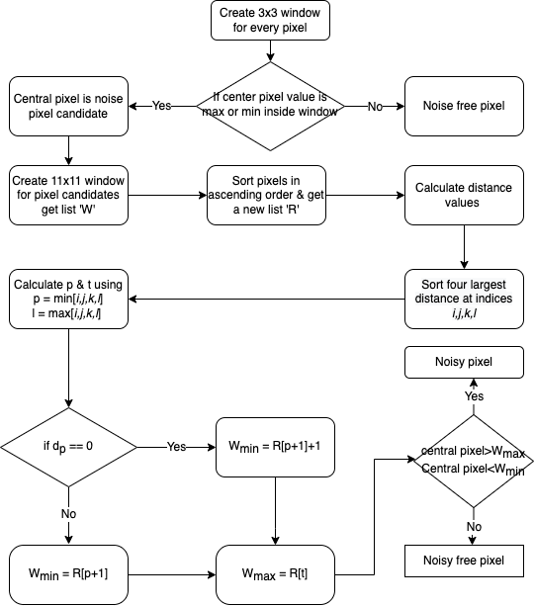

Principle —— noise detection
Input: Original noise image
Output: Binary image
Algorithm:
Using 3X3 windows sort noise pixel candidates
Using 11X11 windows determine final noise pixels

Slide 7
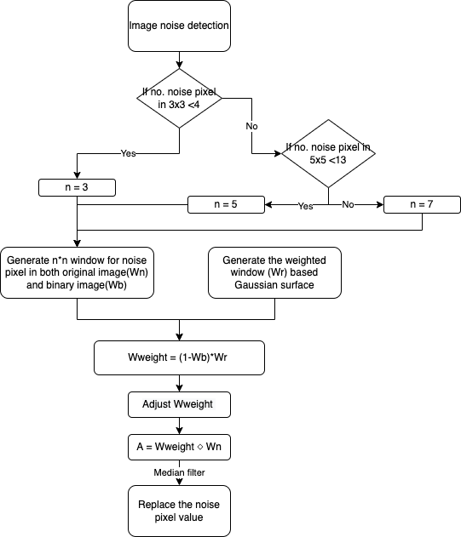
Principle —— noise Removal
Input: Original noise image
Output: Final image without noise pixel
Algorithm:
Give 0 weight for the noise pixels
Use weighted window to calculate median value for noise pixel
Adjust window size depend on no. of noise pixel in one window

Slide 8
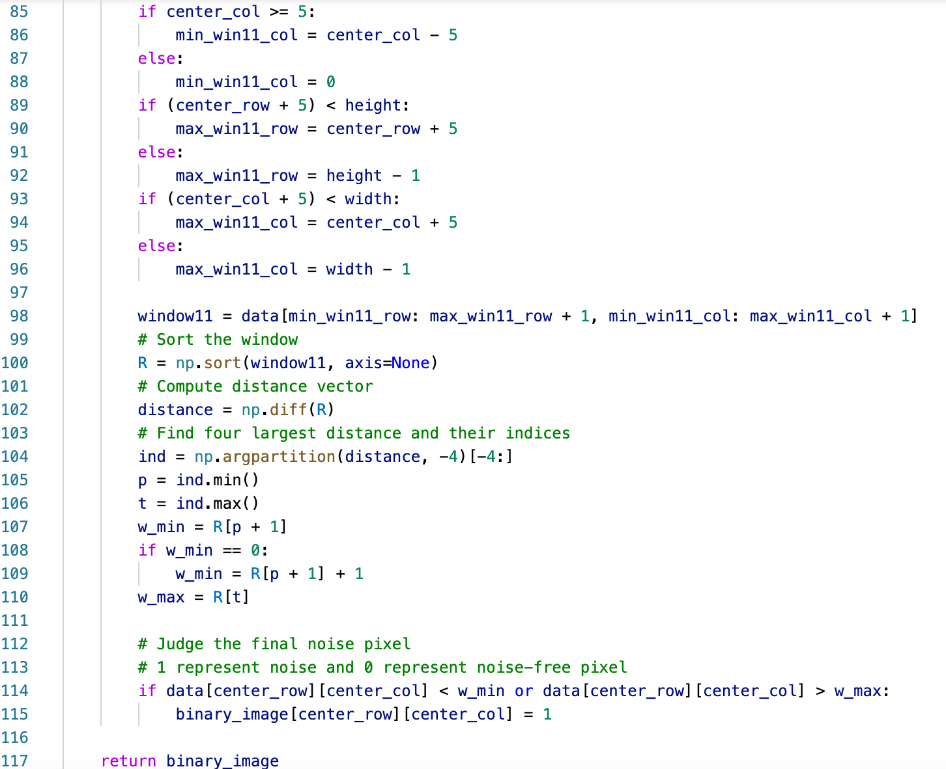
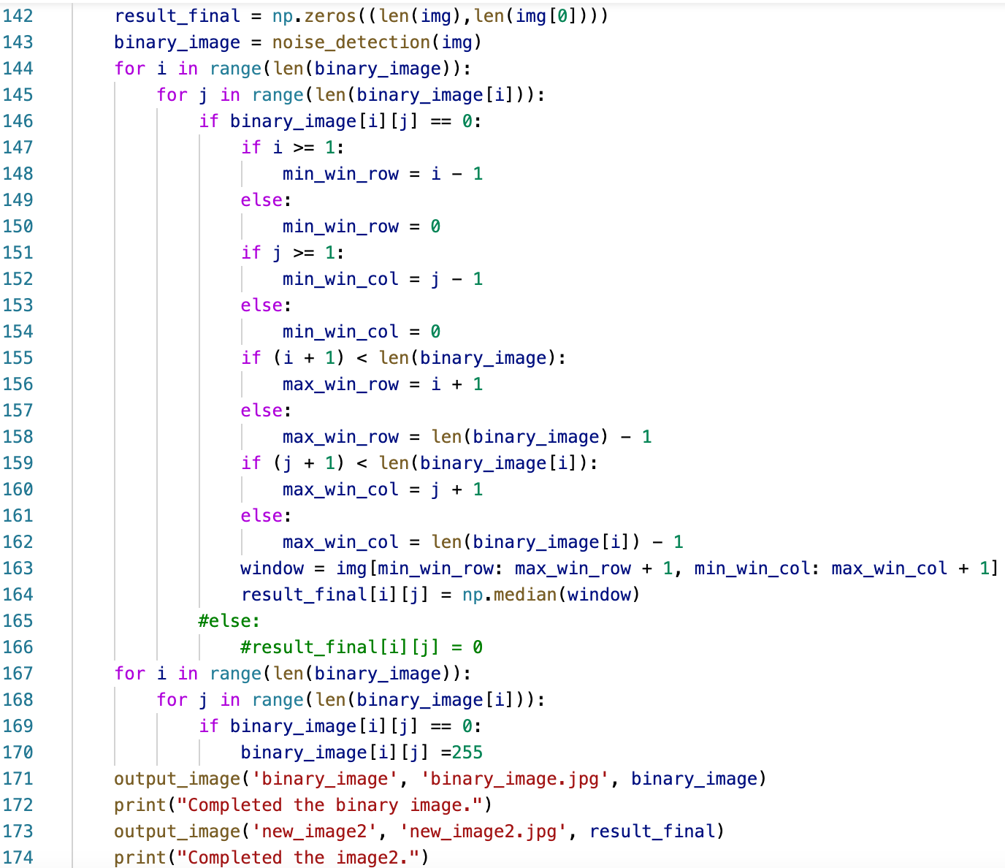
Code

Slide 9

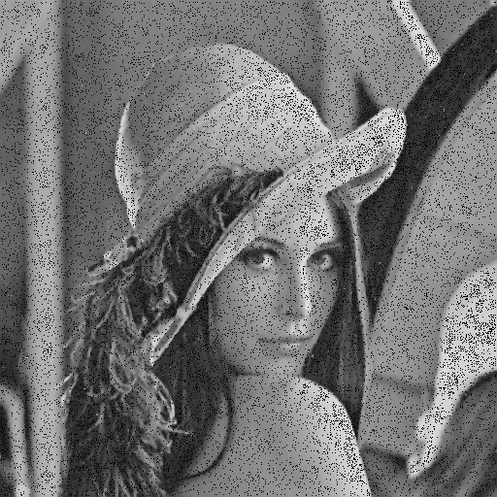
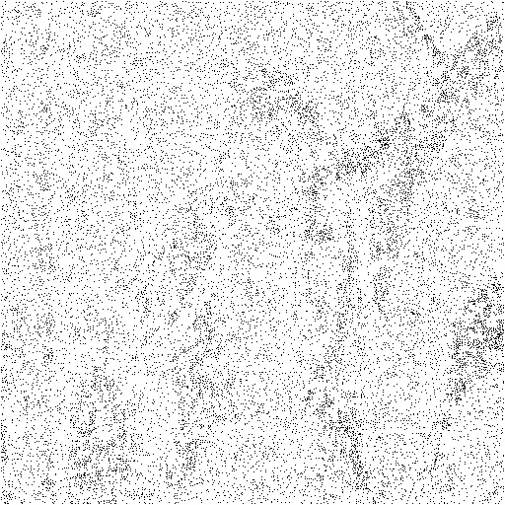
Currently work result
Figure 1: Original image | Figure 2: Image after filtering | Figure 3: Noise positions

Slide 10
Future Plan | 03
Remaining work Question | HPR-Series

Slide 11
Question
Remaining Work
Complete the noise removal program.
Select tools & set a standard for verifying our method has better results than classical median filter.
Consider adding Gaussian noise filter into our program.
Whether we should filter image’s boundary area by median filter?
With larger window size, like 11X11, should we set new imaginary boundary area for our images?
How to generate Gaussian surface?

Slide 12
reference
Zeng, H., Liu, Y.-Z., Fan, Y.-M., & Tang, X. (2012). An improved algorithm for impulse noise by median filter. AASRI Procedia, 1, 68–73. https://doi.org/10.1016/j.aasri.2012.06.014
Gaussian smoothing. Spatial Filters - Gaussian Smoothing. (n.d.). Retrieved January 28, 2022, from https://homepages.inf.ed.ac.uk/rbf/HIPR2/gsmooth.htm
Python PIL: Gaussianblur() method. GeeksforGeeks. (2019, July 14). Retrieved January 28, 2022, from https://www.geeksforgeeks.org/python-pil-gaussianblur-method/
What are the mean and median filters? (n.d.). Retrieved January 28, 2022, from https://www.markschulze.net/java/meanmed.html
How to apply the arithmetic mean filter to a medical image to improve it? I have written this code but it did not work, there is an error which I could not figure it out. how to apply the arithmetic mean filter to a medical image to improve it? I have written this code but it did not work, there i... -. (n.d.). Retrieved January 28, 2022, from https://www.mathworks.com/matlabcentral/answers/436650-how-to-apply-the-arithmetic-mean-filter-to-a-medical-image-to-improve-it-i-have-wrote-this-code-but
详解图像滤波原理及实现！ - 云+社区 - 腾讯云. (n.d.). Retrieved January 28, 2022, from https://cloud.tencent.com/developer/article/1654881
开发者的网上家园. (n.d.). Retrieved January 28, 2022, from https://www.cnblogs.com/wj-1314/p/11693364.html
BROOK@CV. 开发者的网上家园. (n.d.). Retrieved January 28, 2022, from https://www.cnblogs.com/wangguchangqing/p/6407717.html
Gaussian Filter. 关于高斯滤波的一些理解_大熊-CSDN博客_高斯滤波的优缺点. (n.d.). Retrieved January 28, 2022, from https://blog.csdn.net/lz0499/article/details/54015150
Gaussian filter. Gaussian Filter - an overview | ScienceDirect Topics. (n.d.). Retrieved January 28, 2022, from https://www.sciencedirect.com/topics/engineering/gaussian-filter
https://www.mathworks.com/discovery/image-segmentation.html
K. Martin Sagayam, P. Malin Bruntha, M. Sridevi, M. Renith Sam, Utku Kose, Omer Deperlioglu, Chapter 7 - A cognitive perception on content-based image retrieval using an advanced soft computing paradigm, Editor(s): Tapan Gandhi, Siddhartha Bhattacharyya, Sourav De, Debanjan Konar, Sandip Dey, In Hybrid Computational Intelligence for Pattern Analysis and Understanding, Advanced Machine Vision Paradigms for Medical Image Analysis, Academic Press, 2021, Pages 189-211, ISBN 9780128192955,

